Slide 1
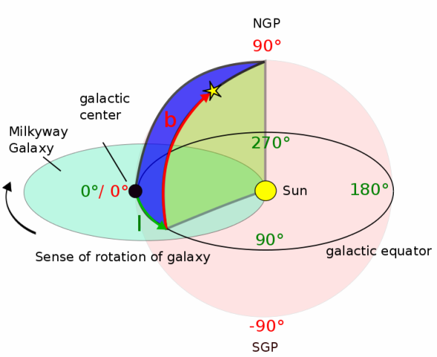
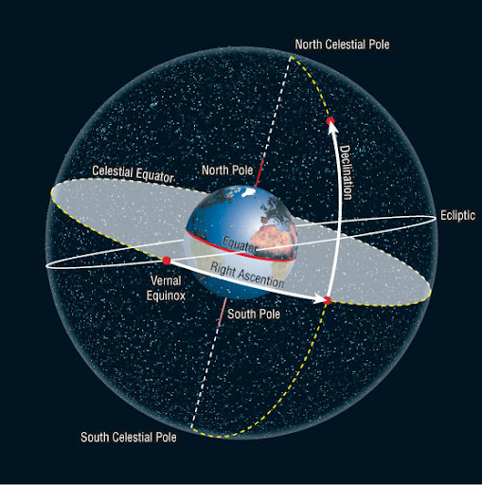
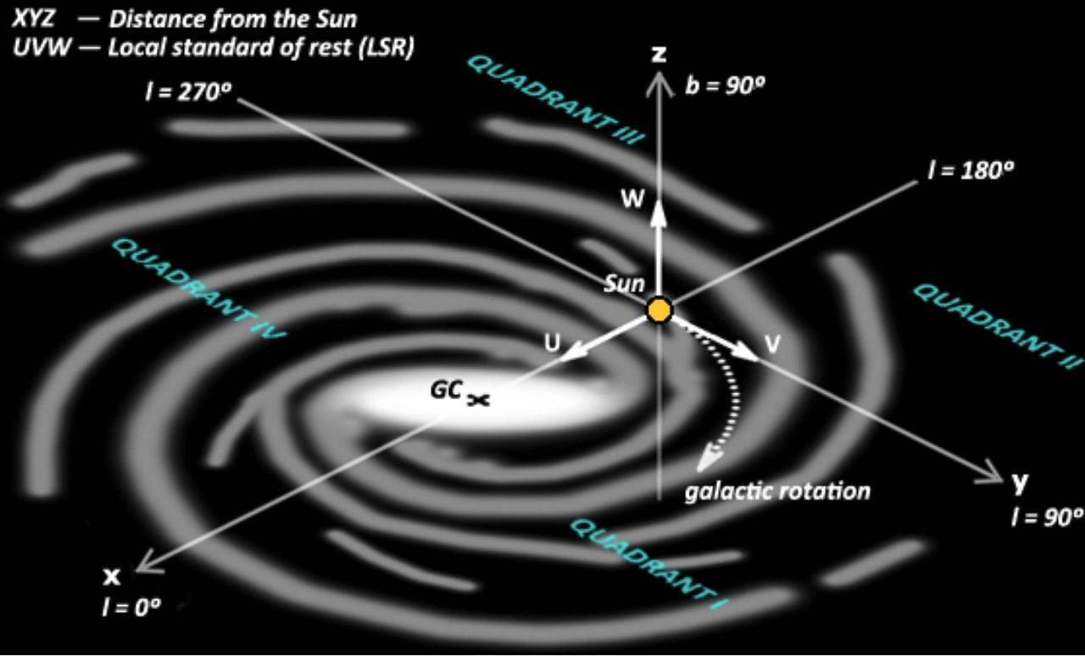
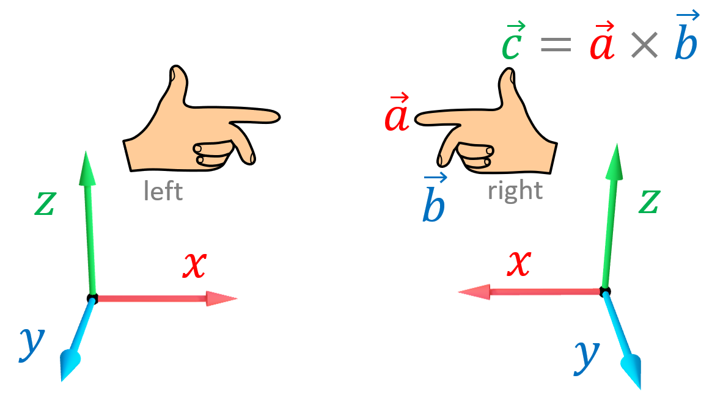
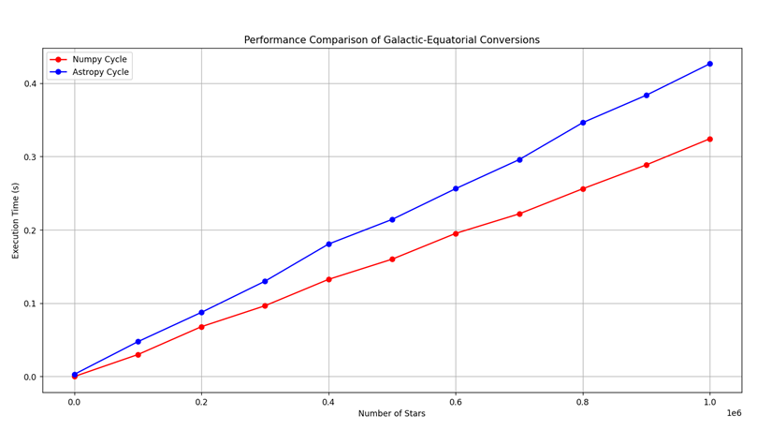
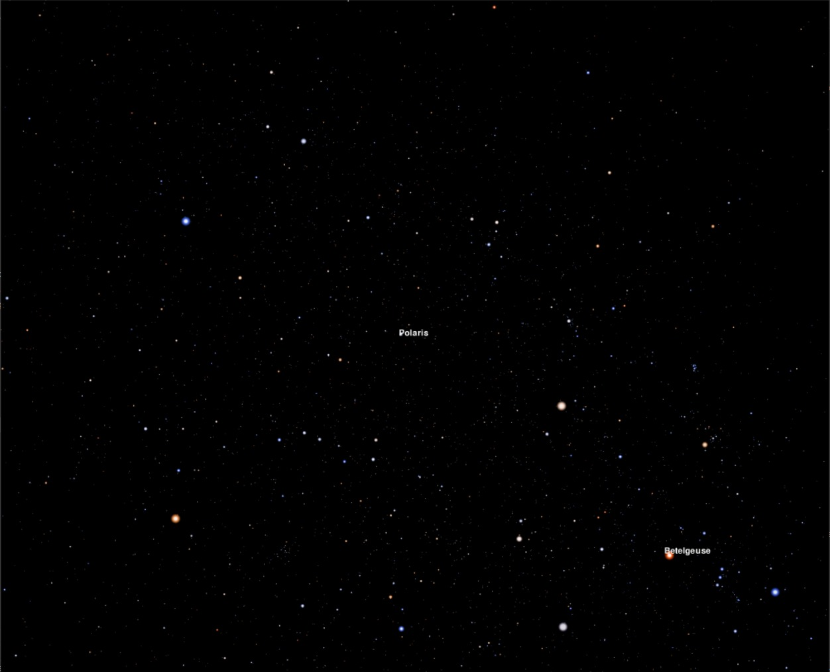
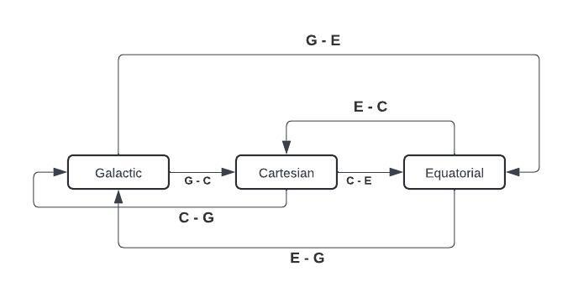
3D Stellar Cartography
Paul Doyle and Rahul Krishna Gajula
School of Computer Science, Grangegorman Campus, Technological University Dublin
Introduction
Analysis, Results and Discussion
In astronomy, precise location tracking of celestial objects across various coordinate systems is fundamental, with the galactic and equatorial systems being extensively used for different observational needs. The galactic coordinate system, aligned with the Milky Way, uses galactic longitude (l) and latitude (b) to measure positions relative to the Galactic Center, providing a heliocentric perspective crucial for understanding the galaxy's structure and dynamics. Conversely, the equatorial coordinate system, aligned with Earth's equator, uses right ascension (ra) and declination (dec) to specify celestial locations as seen from Earth, facilitating the observation of stars and other objects. The Cartesian coordinate system further aids in simplifying transformations between these frames by using linear algebra techniques. For this study, we have chosen the galactic system as our reference point due to its heliocentric nature, which allows for a more direct and meaningful analysis of the Milky Way's features and phenomena.
4 main technical tasks are completed in this project:
Full Coordinate Conversions using mathematical and astropy approaches
Full coordinate conversion cycle and proof of reversibility with Astropy implementation:
Full Coordinate conversion cycle and proof of reversibility with mathematical approach
Key Finding 1: In the galactic coordinate system, the signs of the Cartesian coordinates (x, y, z) depend on the galactic longitude (l), latitude (b), and distance (d). The x value becomes negative when the object is between l = 90° and l = 270°, as cos(l) is negative in this range. The y value becomes negative when l is between 180° and 360°, where sin(l) is negative. The z value is negative when the latitude b is negative, indicating the object is below the galactic plane, as sin(b) is negative for b < 0°. In this context, the observer's perspective significantly influences the orientation of rotations according to the right-hand rule. For instance, at the North Galactic Pole (NGP), the quadrants will be positioned differently compared to the South Galactic Pole (SGP). At the NGP, the quadrants are observed from one side, whereas at the SGP, the same quadrants will appear in reversed positions, essentially on the opposite side. This highlights the importance of the observer's location in determining the orientation of rotational movements and the signs of Cartesian coordinates.
Key Finding 2: In astrometry, converting celestial coordinates between the equatorial (RA/Dec) and Galactic (l/b) systems results in discrepancies due to their fundamental differences. The equatorial system is based on Earth's rotational axis, while the Galactic system aligns with the Milky Way's plane. These systems use different reference planes—the celestial equator for RA/Dec and the Galactic plane for l/b—leading to rotational adjustments in their transformations. Consequently, Cartesian coordinates for the same celestial object differ due to distinct origins (Earth-centered for RA/Dec, Galactic-centered for l/b), reference planes inclined at about 62.6 degrees, and different zero points for measuring angles. These differences necessitate careful consideration when selecting a coordinate system for astronomical analyses.
Performance test between mathematical approach and Astropy approach:
Range of Data Sizes: The test iterates over data sizes ranging from 10,000 to 1,000,000 stars, increasing in steps of 100,000 stars. This broad range tests the methods' performance under both light and heavy computational loads. For each iteration, a new set of random galactic coordinates and distances is generated. This ensures that each test is performed on unique data, thus preventing any caching mechanisms or optimization shortcuts from influencing the results. This randomness is crucial for a fair evaluation of the performance characteristics.
Stereographic Projection of the Bright Star Catalog as of Epoch 2000 time (01/01/2020 00:00)
A stereographic projection is a method of projecting a sphere onto a plane, often used in cartography and astronomy. In this context, it refers to a projection of the 3D points in space constructed using gathered star data to match the observation from a given location at a given time.
3D Rotation Proof of Concept (Live Demo Available)
Demo of Right-Hand Rule as well as independent 3D Axis rotations
Sanity checking star positions as a test mechanism using test waypoints and real stars
The Galactic Coordinate System
The Equatorial Coordinate System
The Cartesian Coordiante System
Objectives, Motivations and Challenges
Objectives and Motivations:
Develop interactive 3D maps of the universe using stereographic projection, extending platforms like Stellarium.
Enable users to explore space in three dimensions with accurate data on distances, types, and positions.
Enhance public engagement through use in observatories such as Blackrock Castle Observatory.
Develop an interactive interface for users to query detailed star information with a backend AI Tool.
Ensure high accuracy in celestial position representation through tested coordinate conversion methods.
Foster a sense of location within the stellar framework, making the universe's vast scale tangible and accessible and explore the night sky from different stellar positions.
Inspire curiosity and a deeper connection to astronomy in learners of all ages, igniting a passion for exploration and discovery.
Challenges:
Performance comparison between Python calculations and the Astropy package for coordinate conversions to ensure efficiency and accuracy.
Transitioning from Python to more efficient graphic systems for improved performance.
Realistically representing size differences of celestial objects on a 2D screen without stars of vastly different magnitudes disappearing and based on apparent distances.
Maintaining up-to-date and relevant data by combining multiple data sources such as BSC, GAIA, and HYG, and expanding the datasets to include stars visible from other parts of the night sky.
Accurately projecting star motion over time despite the lack of true motion information for many stars.
Creating a complete view of the galaxy is hindered by unobservable regions due to our location and intervening dust and objects, resulting in only a partial view.
Reprojecting the night sky from an arbitrary position in space instead of simulating moving through the galaxy. This will potentially reduce overall computational overhead.
The creation of our star dataset involved converting the Bright Star Catalog to a CSV file, selecting key columns, and renaming the parallax column. This dataset was merged with the HYG v4.0 catalog using Python and Pandas, incorporating additional attributes like magnitude and luminosity. Finally, RGB color data from a GitHub repository was integrated by matching HD numbers, enhancing the dataset further.
The following coordinate conversions were performed using standard mathematical formulas as well as a python package called Astropy which is tailored for astronomical conversions.
Technical Specifications: Python 3.9.12 – Packages used: Pygame, Skyfield, Numpy, Pandas, Math, Pytz, Datetime, Astropy
Methodology and Technical Specifications
Conclusion and Future Works
Future work on this project includes the integration of AR/VR technologies to enhance the immersive experience of exploring the universe. We plan to incorporate AI interactivity, allowing an AI system trained in astronomy, such as ChatGPT, to query information about objects not currently on the screen and answer astronomical questions. Enhancing data filtering capabilities will be crucial, enabling users to filter starmaps and access larger astronomical datasets, such as Gaia, for more comprehensive exploration. Additionally, we aim to extend the concept from stars to galaxies by utilizing galaxy datasets, broadening the scope and impact of the project.

